Slide 1

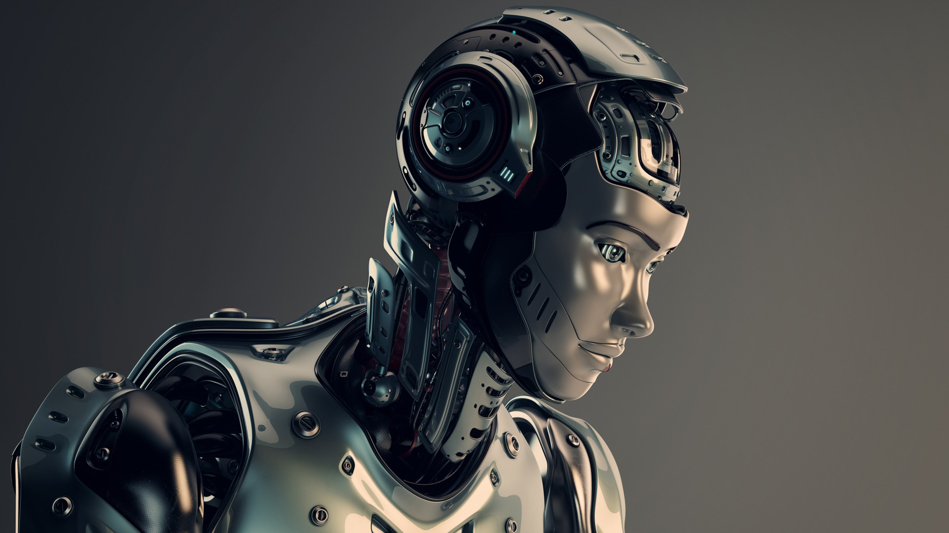

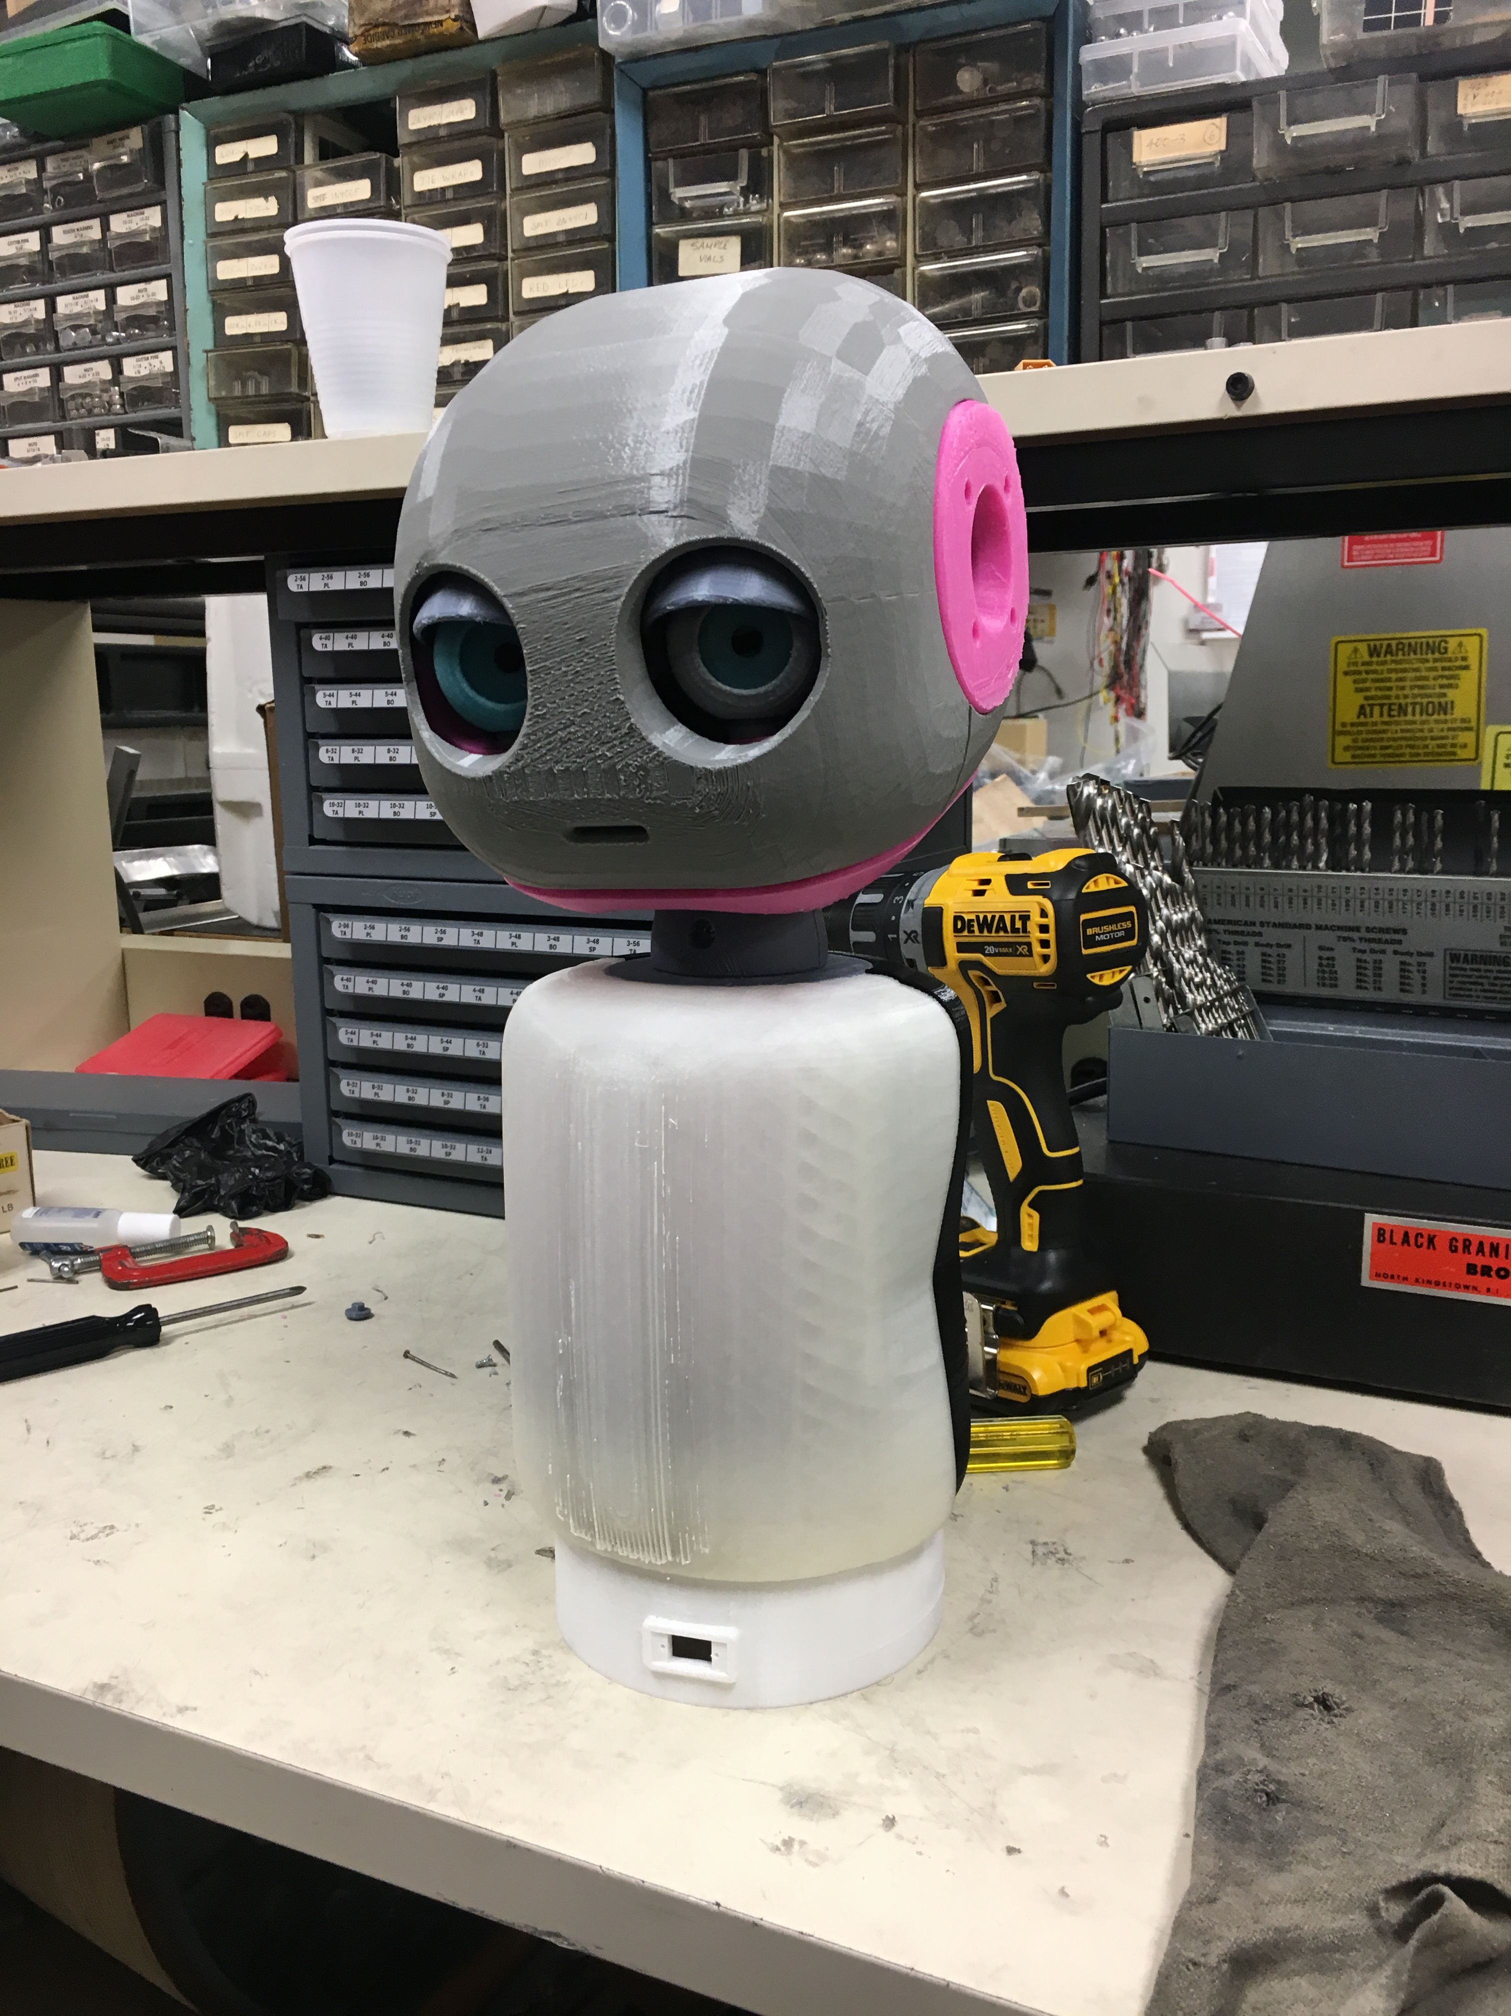
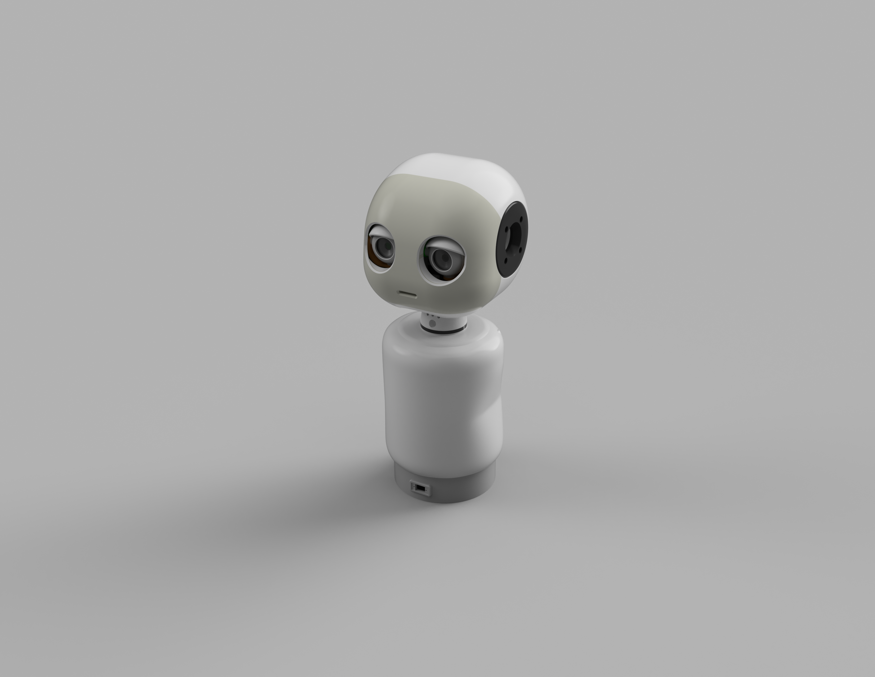
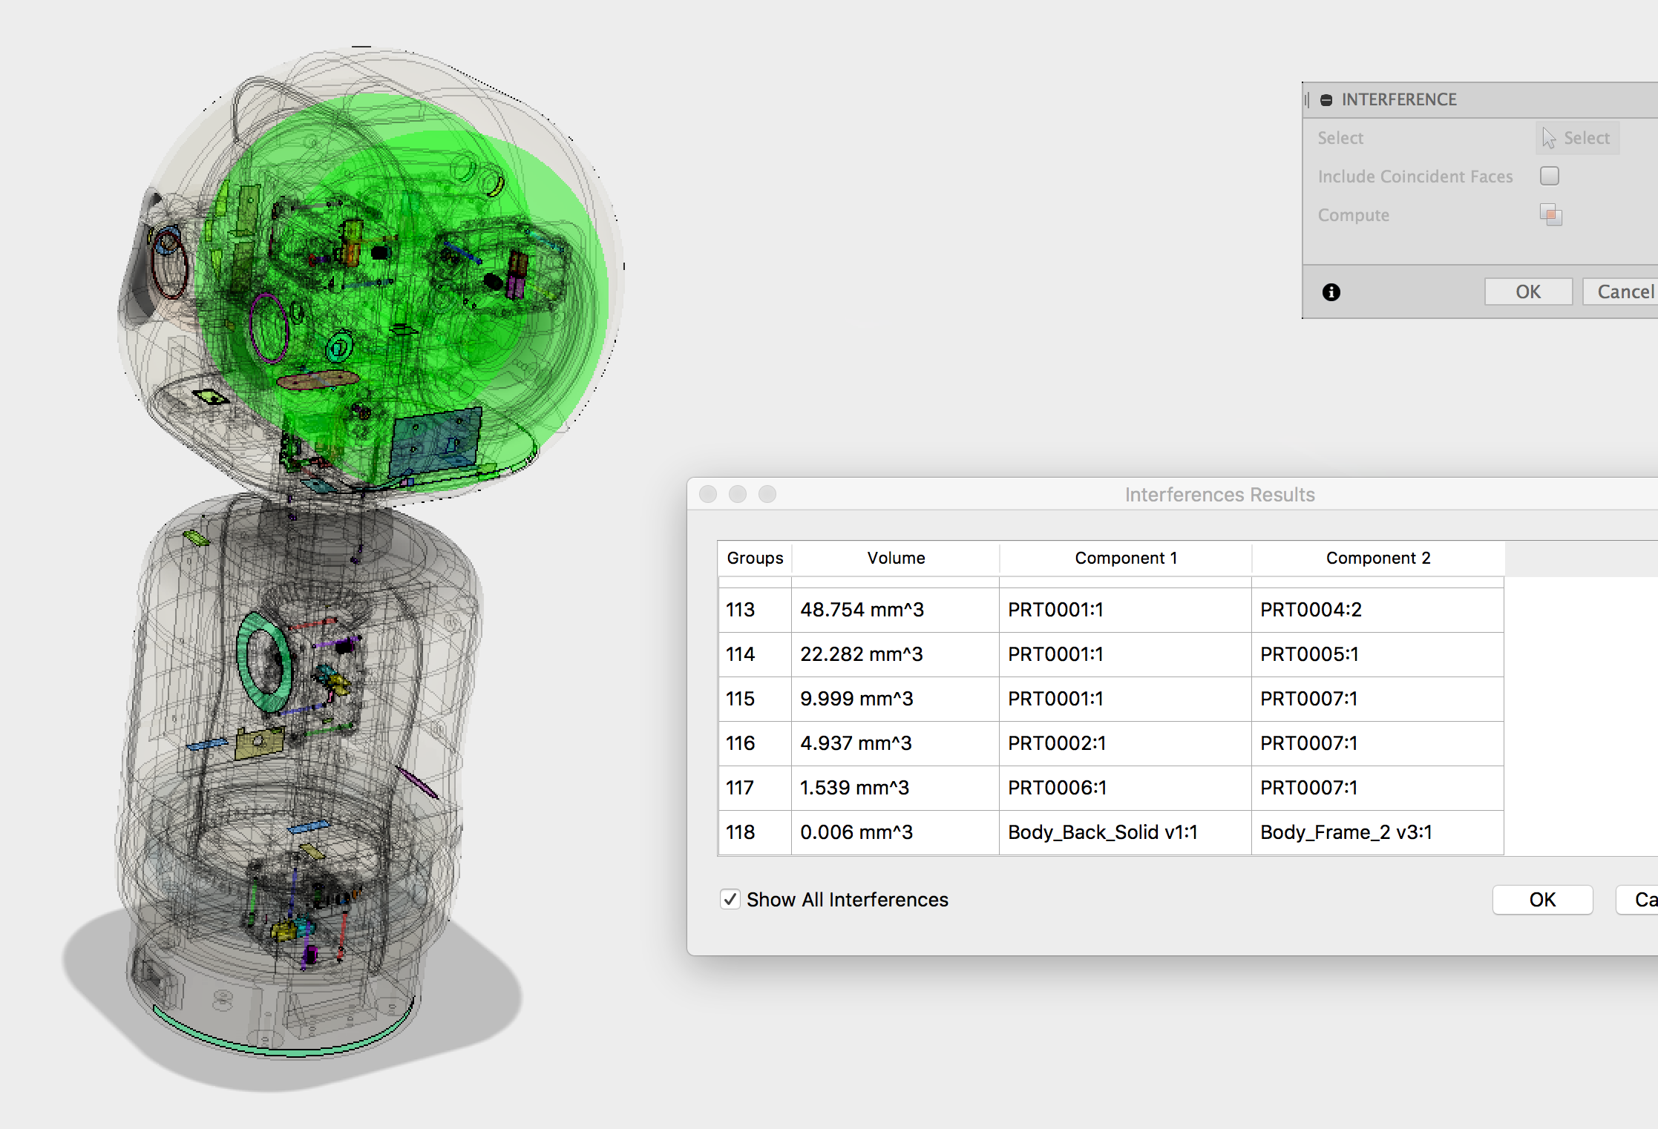
MAKI
Levern Currie | lcurrie2@gmu.edu
Psychology and Electrical and Computer Engineering | George Mason University
RESEARCH QUESTION
How do we get people acclimated and used to actively interacting and being in the presence of artificial agents in all aspects of human life?
INTRODUCTION
Maki is a humanoid autonomous robot that is designed to be used for human robot interaction within the home. The study will be designed to have individuals' take Maki home and interact with it much like a Siri or Amazon Alexa. And record the various interactions in order to add improvements and modifications for better Maki’s.
ABSTRACT
Studying autonomously intelligent agents that are able to interact in a manner that is similar to that of a human. In order to get people used to interacting with these kind of agents.
Figure 2: 3D Rendering of Maki in Fusion 360
Figure 3: Completed Maki
FUTURE DIRECTIONS
The ultimate purpose would be to see how we can start establishing better baselines of interaction and user interface, so that we can better incorporate these machines into the live of the average individual.
Figure 1 – Localization of Individual Interferences
ACKNOWLEDGEMENTS
Alberto Perez

